Slide 1
Fault-Tolerance, Process Resilience, Distributed Commit
Lecture-28, Lecture-29, Lecture-30

Slide 2
Introduction
A system is said to fail when it does not meet its specification.
Computer system can fail due to a fault in some component, such as a processor, memory, I/O device, cable, or software.
A fault is a malfunction, possibly caused by a design error, a manufacturing error, a programming error, physical damage, harsh environmental conditions, unexpected inputs, operator error etc.
Faults are generally classified as:
1. Transient faults: It occurs ones and then diappears. If the operation is repeated, the fault goes away. Ex: Birds contact with satellite, lightening, etc.
2. Intermittent faults: It occurs, then vanishes of its own accord, then reappears, and so on. Ex: A loose contact on a connector.
3. Permanent faults: is one that continue to exist until the faulty component is repaired. Ex: Burnt-out chips, software bugs, disk head crashes etc.

Slide 3
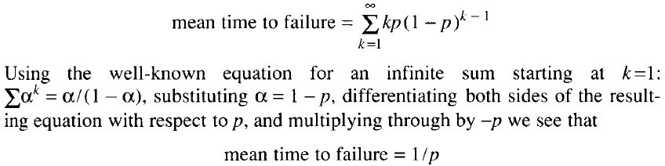
Cont..
The goals of desigining and building FT systems is to ensure that the system as a whole continues to function correctly, even in the presence of faults.
If some component has a probability p of malfunctioning in a given second of time, the probability of it not failing for k consecutive seconds and then failing is p(1-p)^{k}.
The expected time to failure is given by:
For example: if the probability of a crash is 10⁻⁶ per second, the mean time to failure is 10⁶ sec.

Slide 4
System Failures
Two types of processor faults can occur:
1. Fail-Silent Faults: In this, a faulty processor just stops and does not respond to susequent input or produce further output, except perhaps to announce that it is no longer functioning.
These are also called fail-stop faults.
2. Byzantine faults: A faulty processor continues to run, issuing wrong answers to questions, and possibly working together maliciously with other faulty processors to give the impression that they are all working correctly.
Synchronous systems: A system that has the property of always responding to a message within a known finite bound, if it is working, is said to be synchronous. A system not having this property is said to be Asynchronous.

Slide 5
Cont..
Use of Redundancy:
The general approach to fault tolerance is to use redundancy.
Three kinds are possible: information redundancy, time redundancy, and physical redundancy.
With information redundancy, extra bits are added to allow recovery from garbled bits. Example: Hamming code.
With time redundancy, an action is performed and then, if need be, it is performed again. For example if a transaction aborts, it can be redone with no harm.
Time redundancy is especially helpful when the faults are transient or intermittent.
With physical redundancy, extra equipment is added to make it possible for the system as a whole to tolerate the loss or malfunctioning of some components. For example: extra processors can be added to the system so that if a few of them crashes, the system can still function correctly.

Slide 6
Cont..
There are two ways to organize these extra processors: active replication and primary backup.
1. FT using Active Replication (AR): Consider the case of a server. When AR is used, all the processors are used all the times as servers (in parallel) in order to hide faults completly.
AR is a well-known technique for providing FT using physical redundancy.
It is also known as state-machine approach.
Consider, for example, the circuit of Fig. 4-21(a) (next slide). Here signals pass through devices A, B, and C in sequence.
If one of them is faulty, the final result will probably be wrong.
In Fig. 4-21(b), each device is replicated three times.
Following each stage in the circuit is a triplicated voter.
Each voter is a circuit that has 3 inputs and 1 output.
If two or three of the inputs are the same, the output is equal to the input. If all three inputs are different, the output is undefined.
This kind of design is known as Triple Modular redundancy (TMR).

Slide 7
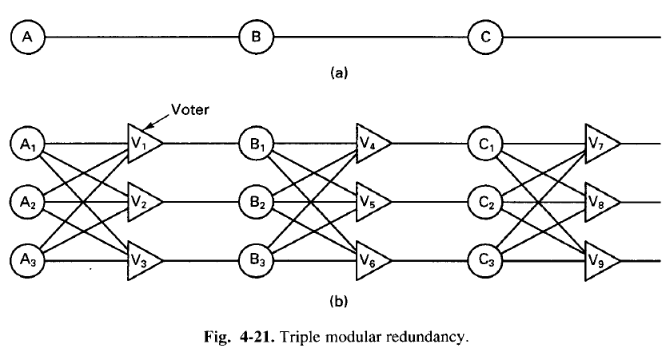
Cont..

Slide 8
Cont..
Different cases:
CASE-I: Suppose element A2 fails. Each of the voters V1, V2, and V3 gets two good (identical) inputs and one rogue input and each of them outputs the correct value to the second stage. In essence, the effect of A2 failing is completely masked so that the inputs to B1, B2, and B3 are exactly the same as they would have been had no fault occurred.
CASE-2: B3 and C1 are also faulty, in addition to A2. These effects are also marked, so the three final outputs are still correct.
CASE-3: A voter is also a component and can also be faulty.
Suppose, for example, that V1 malfunctions. the input to B1 will then be wrong, but as long as everything else works, B2 and B3 will produce the same output and V4, V5, and V6 will all produce the correct result into stage three.
A fault in V1 is effectively no different than a fault in B1. In both cases, V1 produces incorrect output, but in both cases it is voted down later.

Slide 9
Cont..
2. FT using Primary-Backup (PB):
The essential idea of the primary backup method is that at any one instant, one server is the primary and does all the work.
If the primary fails the backup takes over.
Ideally, the cut over should take place in a clean way and be noticed only by the client operating system, not by the application program.
Primary backup FT has two major advantages over active replication:
First, it is simpler during normal operations since messages go to just one server (the primary) and not to a whole group. Therefore, the problems associated with ordering these messages also disappear.
Second, in practice it requires fewer machines because at any instant one primary and one backup is needed. Although, when a backup is put into service as primary, a new backup is needed instantly.

Slide 10
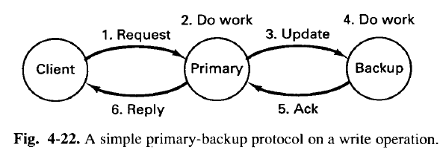
Cont..
On the downside, it works poorly in the presence of Byzantine failures in which the primary erroneously claims to be working perfectly. Also, recovery from a primary failure can be complex and time consuming.
Ex: Consider Fig. 4-22, in which a WRITE operation is dipicted.
The client sends a message to the primary, which does the work and then sends an update message to the backup.
When the backup gets the message, it does the work and then sends an acknowledgement back to the primary.
When the acknowledgement arrives, the primary sends the reply to the client.

Slide 11
Cont..
Now consider the effect of a primary crash at various moments during an RPC:
If the primary crashes before doing the work (before Step 2), no harm is done. The client will time-out and retry.
If the primary crashes after doing the work but before sending the update (i.e., after Step 2), when the backup takes over and the request comes in again, the work will be done a second time.
If the primary crashes after Step 4, but before Step 6, the work may end up being done 3 times, once by the primary, once by the backup as a result of Step 3, and once after the backup becomes the primary.

Slide 12
Process Resilience
Fault: It is an incorrect internal state in your system. Ex: Database shutdown, memory leak, blocked thread etc.
Failure: Inability of the system to do the intended job at current time. Ex: Server down.
Resilience: is about preventing faults turning it into failure.
Process can be made FT by arranging to have a group of processes, with each member of the group being identical.
A message sent to the group is delivered to all the copies of the processes (the group members), and then only one of them will perform the required services.
If any one of the process fails, it is assumed that other process will still be able to do the function.

Slide 13
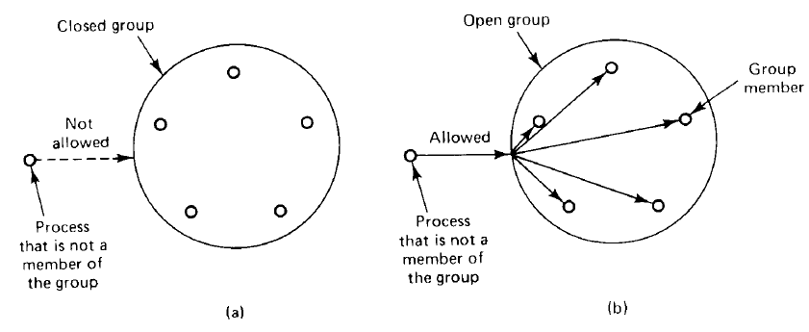
Cont..
Types of Groups:
1. Closed Groups Vs Open Groups: In closed group, only the members of the group can send messages to the other members of the group.
Outsiders cannot send messages to the group as a whole, although they may be able to send messages to individual members.
In open group, any process in the system can send messages to any group.

Slide 14
Cont..
2. Peer Group Vs Hierarchical Group: In Peer Group, all the processes are equal. No one is boss and all the decisions are made collectively.
Advantages: The peer group is symmetric and has no single point of failure. If one of the processes crashes, the group simply becomes smaller, but can otherwise continue.
Disadvantage: Decision making is complicated. To decide anything, a vote has to be taken, incurring some delay and overhead.
In Hierarchical group some kind of hierarchy exists. For example, one process is the coordinator and all others are workers.
In this model, when a request for work is generated, either by an external client or by one of the workers, it is sent to the coordinator.
The coordinator then decides which worker is best suited to carry it out, and forwards it there.
Here, loss of coordinator brings the entire group to a halt, but as long as it is running, it can make decisions without bothering everyone else.

Slide 15
Distributed Commit
A distributed commit in distributed systems refers to the process of ensuring that all nodes or participants in a distributed system agree on whether a particular transaction or operation should be committed (i.e., applied permanently) or aborted.
It is crucial for maintaining consistency and reliability in systems where data is replicated across multiple machines or locations.
Key Concepts of Distributed Commit:
Atomicity: The process must ensure that either all participants in the transaction commit the operation or none of them do, preserving the atomicity property of transactions.
Consistency: The system should transition from one consistent state to another. The commit process ensures that either all nodes end up with the same data after a transaction or none at all.
Fault Tolerance: The protocol should allow for failures (such as crashes or network partitions) without compromising the consistency of the system.

Slide 16
Cont..
Common Distributed Commit Protocols:
Two-Phase Commit (2PC): The Two-Phase Commit protocol is one of the most commonly used methods for achieving distributed commit in a distributed system. It involves two phases:
Phase 1 (Prepare Phase):
The coordinator (usually a central server or node) sends a "prepare" message to all participants (nodes involved in the transaction), asking them if they are ready to commit.
Each participant responds with either a "Yes" (ready to commit) or "No" (unable to commit, usually due to failure or some inconsistency).
Phase 2 (Commit/Abort Phase):
If all participants reply with "Yes", the coordinator sends a "commit" message, instructing all participants to apply the transaction and commit it.
If any participant responds with "No", the coordinator sends an "abort" message, and all participants must roll back the transaction.
Issues: 2PC can be blocked if a participant or coordinator crashes after the prepare phase but before the commit/abort decision.

Slide 17
Cont..
Three-Phase Commit (3PC): The Three-Phase Commit protocol extends 2PC to address the blocking problem. In 3PC, there are three phases:
Phase 1 (Can Commit Phase): The coordinator asks if the participants are able to commit.
Phase 2 (Pre-Commit Phase): The coordinator sends a pre-commit message if all participants agree to commit.
Phase 3 (Commit Phase): After the pre-commit phase, the coordinator finally instructs the participants to commit the transaction.
Non-blocking: The 3PC protocol is designed to avoid blocking situations by introducing more steps and making it more resilient to failures during the commit process.
However, it is still subject to certain edge cases, especially in the case of network partitions or failures.

Slide 18
Cont..
Paxos Commit: Paxos is a consensus algorithm that can be used to ensure distributed agreement in a commit process.
It works by ensuring that a majority of nodes agree on a decision, even in the presence of failures.
Paxos is more complex but highly fault-tolerant and guarantees that the decision to commit or abort is made even in the presence of network partitions or node failures.
Raft Commit: Raft is another consensus algorithm similar to Paxos, designed to be more understandable and easier to implement.
Raft ensures distributed consensus by having a leader that coordinates log replication across all nodes.
When the leader commits a log entry, it guarantees that the operation is consistent and will be applied to all nodes.

Slide 19
Cont..
Failure Scenarios and Recovery:
Crash Failure: If a node crashes during a commit, it must recover the transaction state upon restart.
This could involve the use of logs or write-ahead logs (WAL) to determine whether to commit or abort the operation.
Network Partition: If a network partition occurs, some nodes might not be able to communicate with others.
Distributed commit protocols like 3PC or Paxos attempt to handle these scenarios by allowing nodes to proceed with operations while maintaining the consistency of the system.
Coordinator Failure: If the coordinator fails after sending the "prepare" message but before making the final commit/abort decision, the system could get stuck.
To avoid this, protocols like Paxos and Raft elect new leaders or coordinators to ensure progress.

Slide 20
Cont..
Challenges in Distributed Commit:
Latency and Network Partitioning: In large distributed systems, communication latency between nodes and network partitioning can cause delays or prevent nodes from agreeing on a commit decision.
Atomicity and Isolation: Ensuring that all participants commit or abort at the same time, especially in the face of network or node failures, is difficult but essential to prevent inconsistencies.
Scalability: As the number of nodes in the distributed system grows, the overhead of coordinating commit decisions also increases, leading to potential bottlenecks or performance degradation.
Liveness and Blocking: Some protocols, such as 2PC, can potentially block indefinitely in the case of failures or timeouts, which could lead to a system that is not always available.

